Slide 1



AD-Hoc Insights Consumer Goods
Presented by Shweta

Slide 2
Objectives
• Atliq Hardware(fictitious Corporation)is one of the major computer hardware manufactures in india,with strong presence in other nations.
• Be that as it may, the management acknowledged a lack of sufficient insights to support prompt, informed, and strategic decision-making.
• planed to expand the data analytics team by adding junior data analysis.
To assess candidates, Data Analytics director, Tony Sharma plans to conduct a sql challenge to evaluate both tech and soft skills.
The company seeks insights for 10 ad hoc requests.

Slide 3

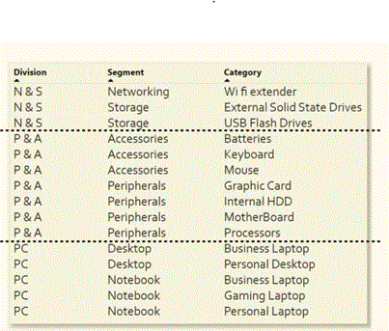
Company Overview
Atliq Hardware is a computer hardware and accessory manufacturer.
Fiscal Year-September to August

Slide 4
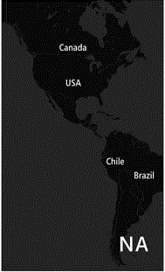
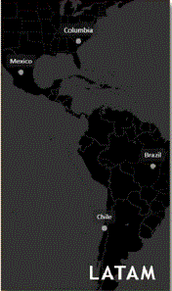
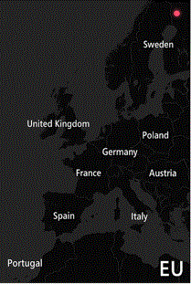
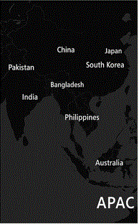
Company’s Market

Slide 5

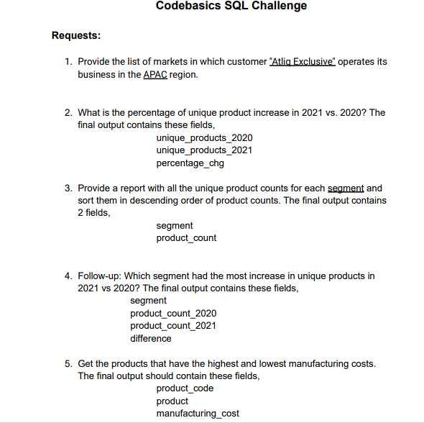
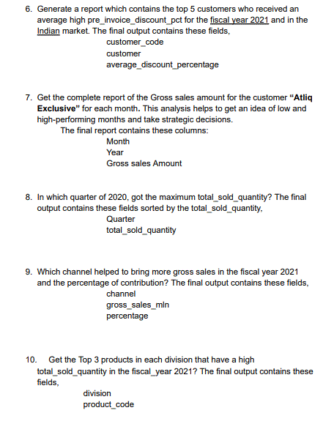
Problem Statement

Slide 6
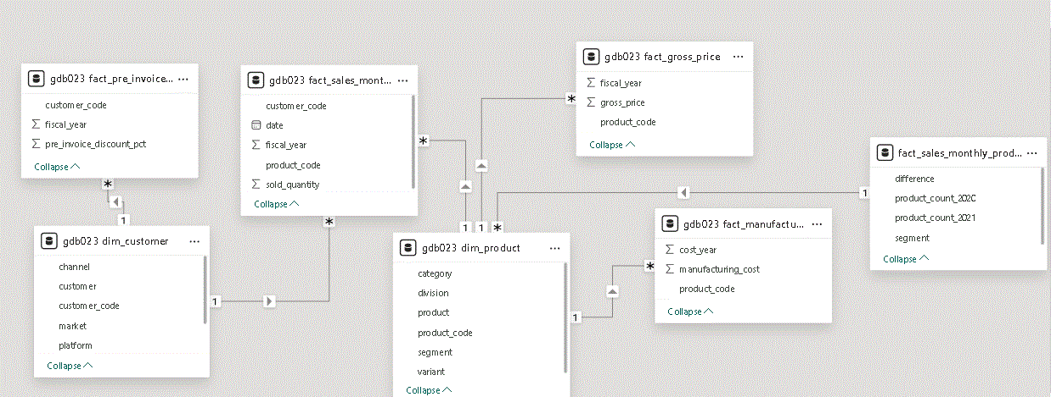
Data Collection

Slide 7

Analysis & Discoveries

Slide 8
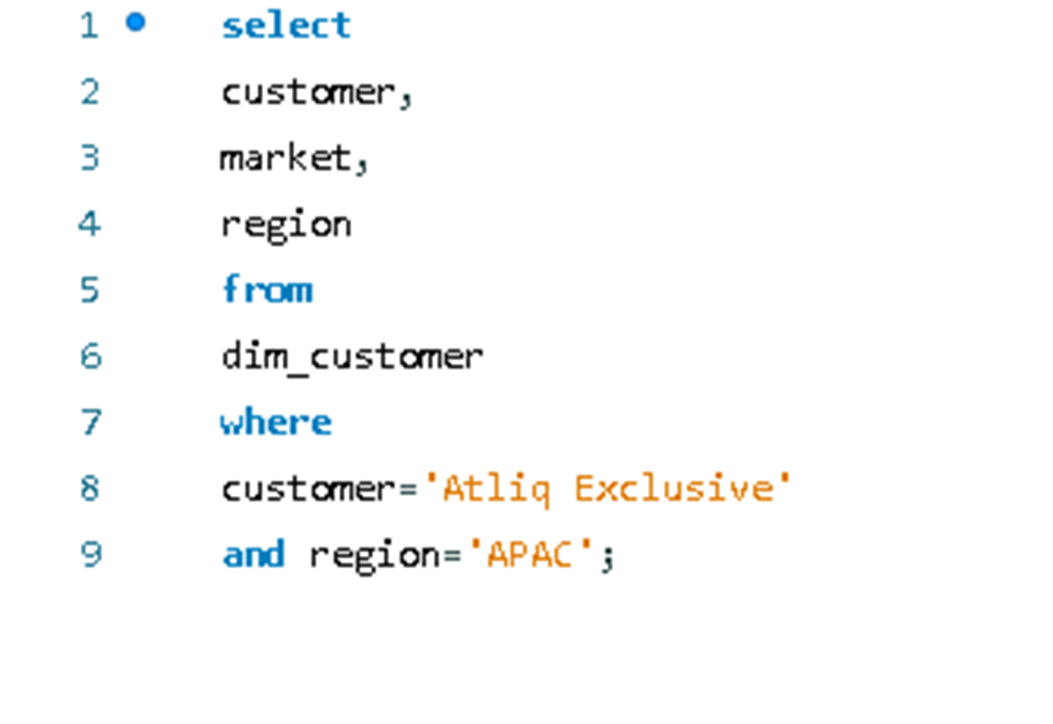
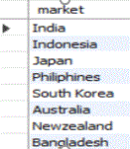
Request-01
Requirement:
Provide the list of markets in which customer "Atliq Exclusive" operates its business in the APAC region.
SQL Query: Output

Slide 9
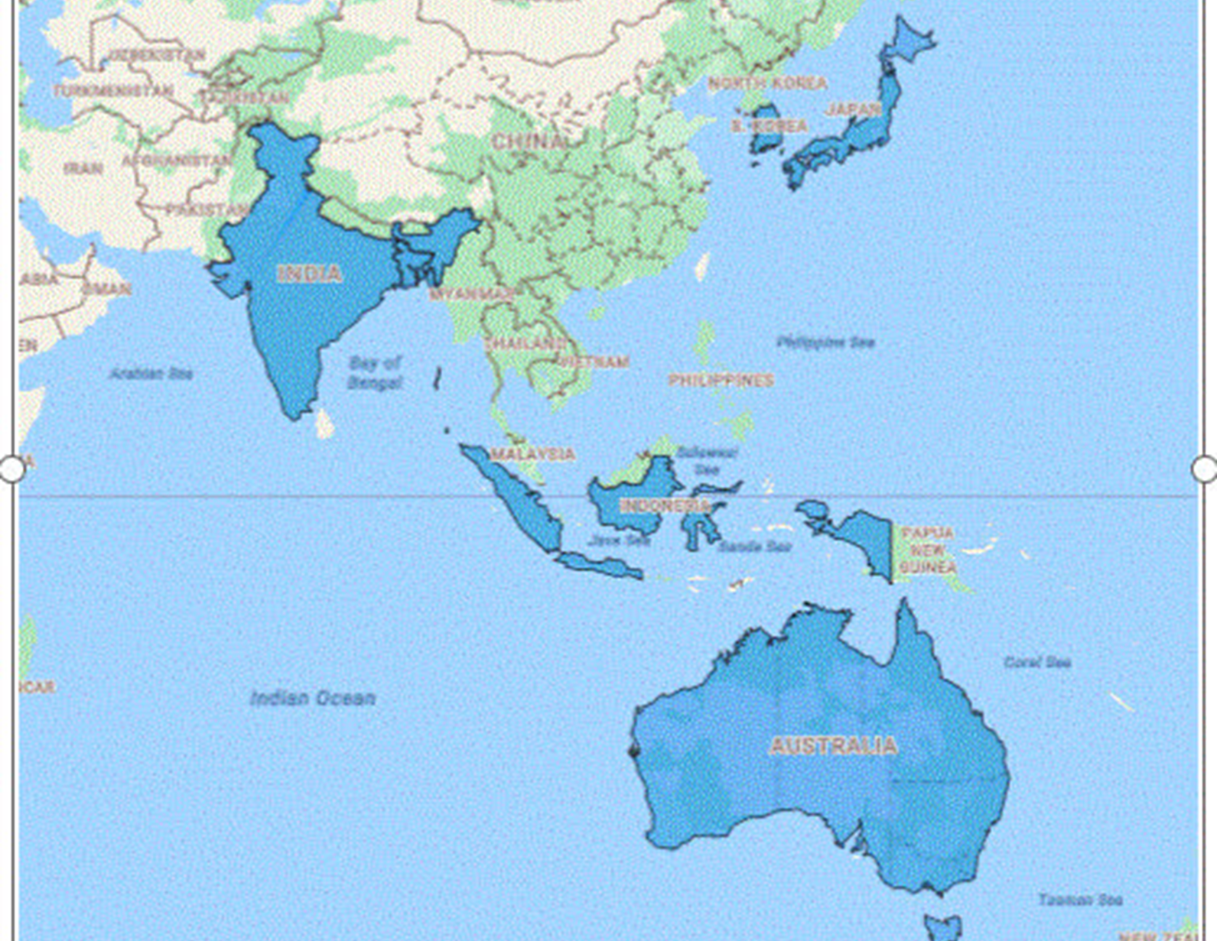
Insights
•Broad APAC Reach: Atliq Exclusive is present in key markets like India, Japan, South Korea, and more, covering a wide APAC region.
• Growth in Emerging Markets: There’s strong potential for expansion in fast-growing markets like India and Indonesia.
• Customized Local Strategies: Atliq Exclusive can tailor its approach to each market for better customer connection and success.

Slide 10
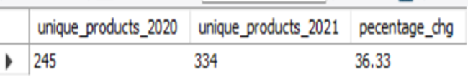
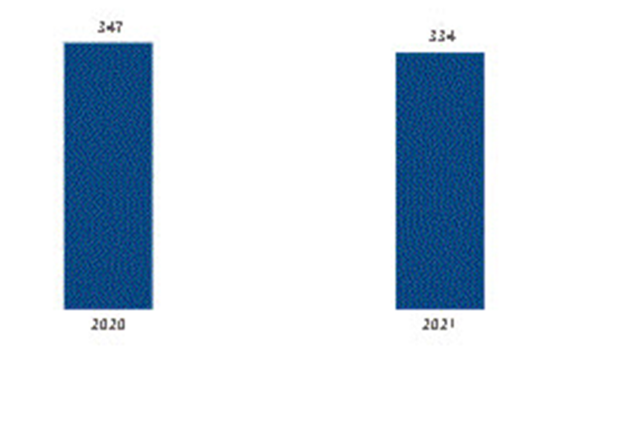
Result
Request-02
Requirement:
What is the percentage of unique product increase in 2021 vs. 2020?
Output:
Insights:
In 2021, the number of unique products sold dropped by 3.75% compared to 2020
This indicates a slight reduction in product variety offered or sold during the year

Slide 11
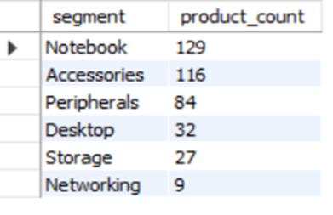
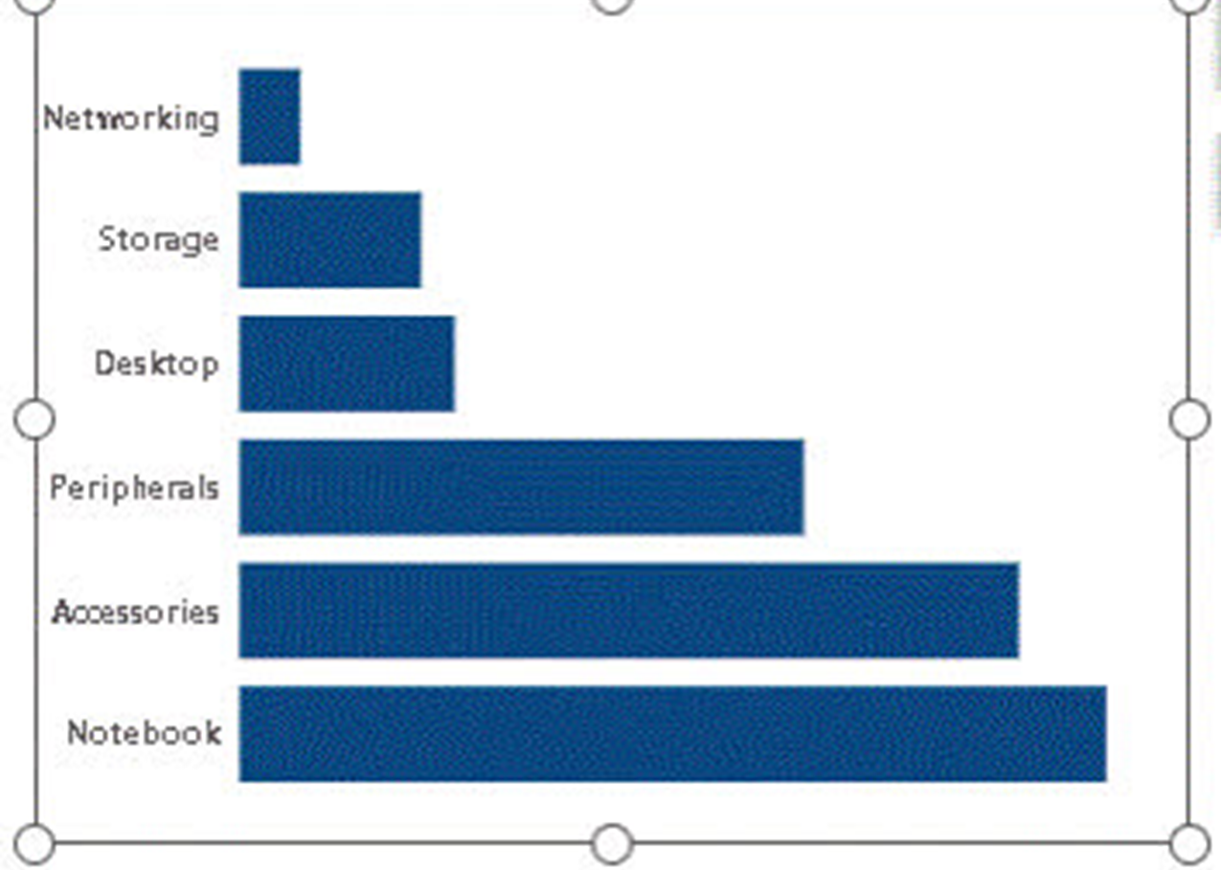
Result:
Request-03
Requirement:
Provide a report with all the unique product counts for each segment and sort them in descending order of product counts.
Output:
Insights:
Notebooks are leading with 129 sales, followed closely by accessories at 116. This shows a strong preference for portable devices.
• Desktops (32 sales), storage (27), and networking (9) are trailing behind, indicating a shift towards more flexible, mobile tech solutions.

Slide 12
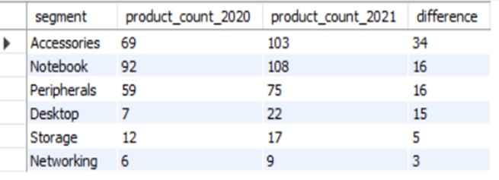
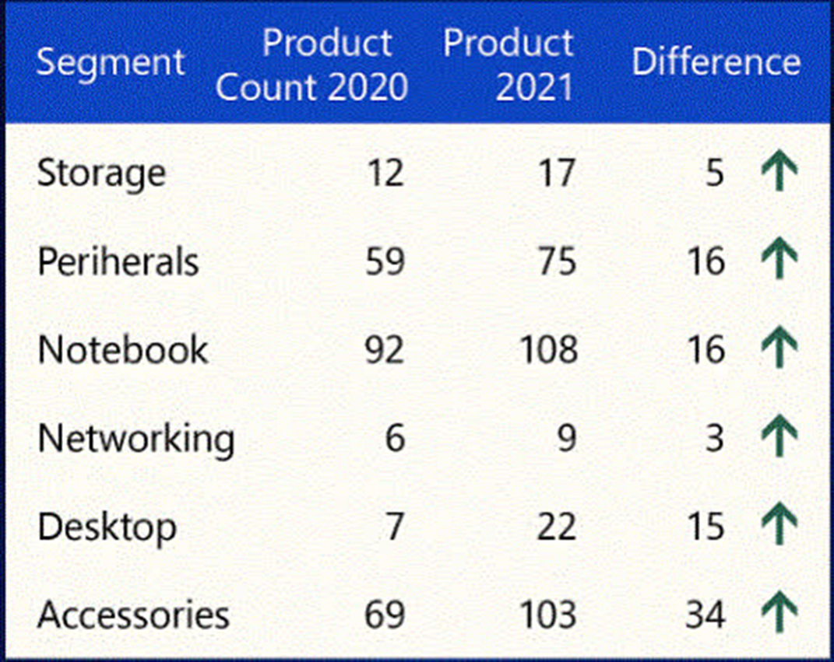
Result
Request-04
Requirement:
Which segment had the most increase in unique products in 2021 vs 2020?
Output:
Insights
• Accessories had the largest increase production.
• storage/networking grew a little, but they’re still not keeping up with the rise in accessories and notebooks.

Slide 13
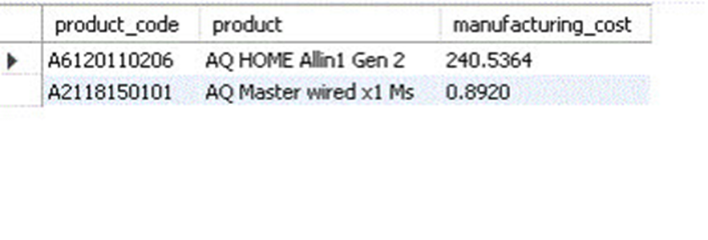
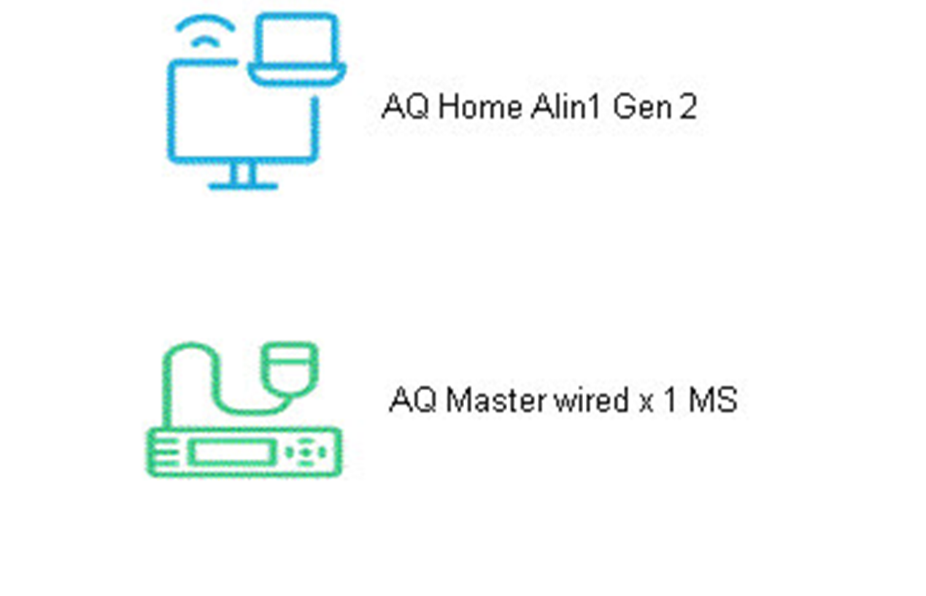
Result:
Request-05
Requirement:
Get the products that have the highest and lowest manufacturing costs.
Output:
Insights
•The AQ HOME Allin1 Gen 2 desktop has a manufacturing cost of 240.54, while the AQ Master wired x1 Ms accessory comes in at just 0.89.
•The difference is pretty clear – desktops are much more expensive to produce, while accessories keep things light on the budget !

Slide 14
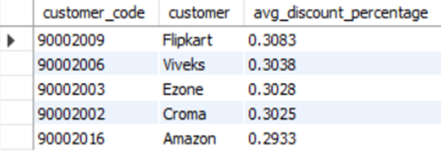
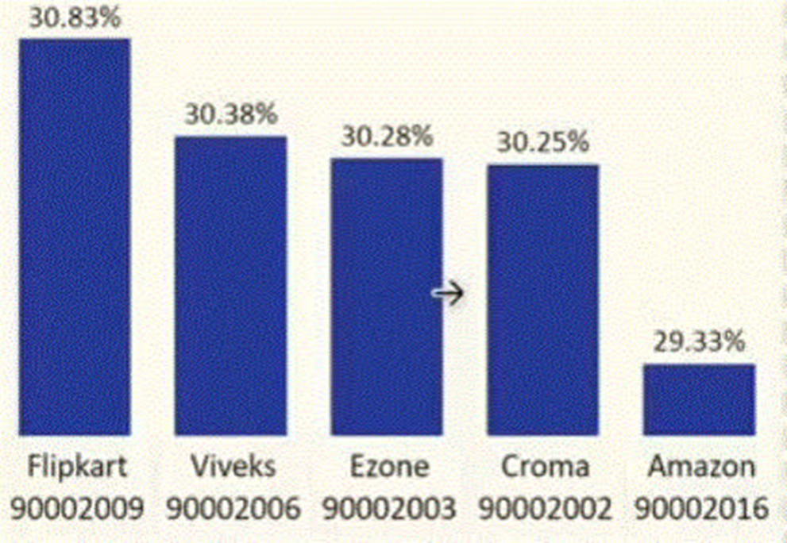
Result:
Request-06
Requirement:
Generate a report which contains the top 5 customers who received an average high pre_invoice_discount_pct for the fiscal year 2021 and in the Indian market.
Output:
Insights
•Flipkart offers the highest average discount at 0.3083.
•The Least average pre-invoice discount was given to amazon .

Slide 15
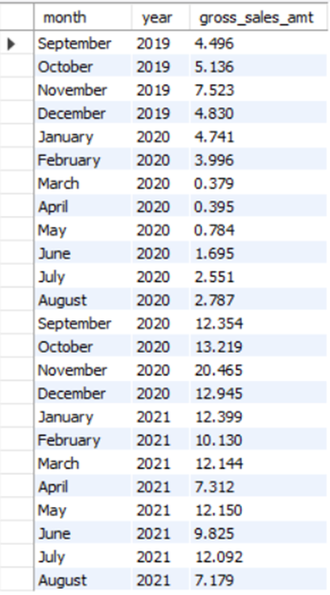
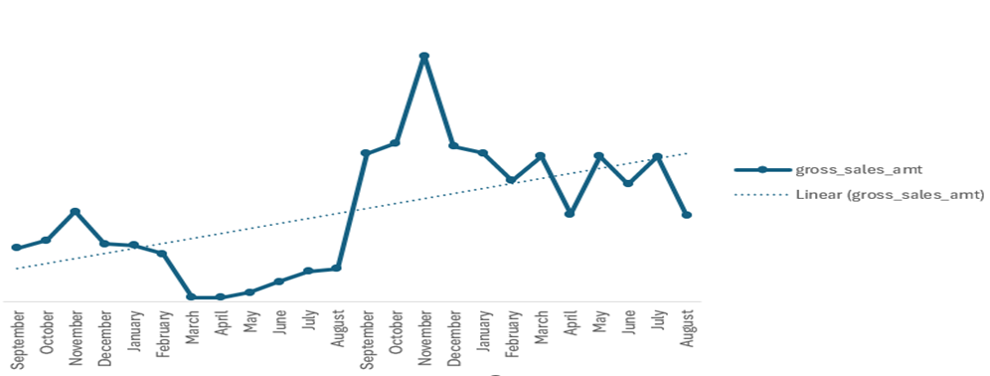
Requirement:
Get the complete report of the Gross sales amount for the customer “Atliq Exclusive” for each month .
Request-07

Slide 16
Insights
2019: Sales were steady, with a peak in November, but dropped a lot in March and April 2020, probably due to the pandemic.
2020: Sales really picked up in September and kept going up in October and November, but dropped again toward the end of the year.
2021: Sales started lower compared to late 2020, went up in May, but dropped again in August.
Summary: Sales went up a lot in 2020 after the tough start, but since then, they’ve been going up and down.

Slide 17
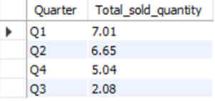
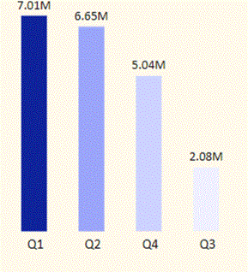
Result:
Request-08
Requirement:
In which quarter of 2020, got the maximum total_sold_quantity?
Output:

Slide 18
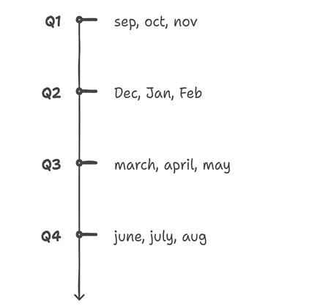
Insights
Q1 2020 had the highest sales volumne at 7 million units showing strong start the year.
Sales dropeed sharply in Q3(march-may)2020,likely due to the covid-19 pandemic.

Slide 19
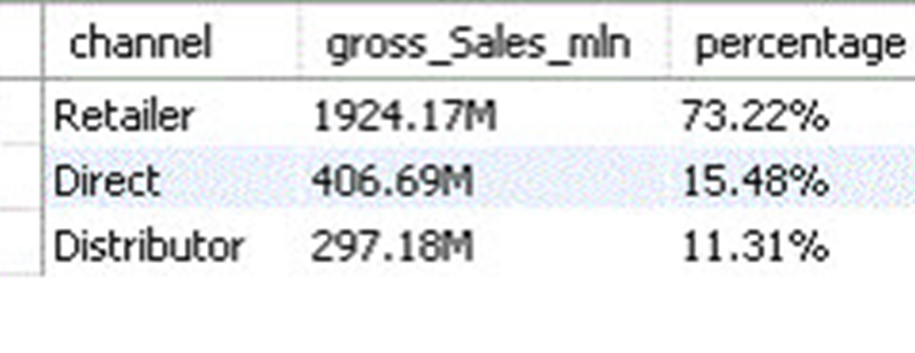
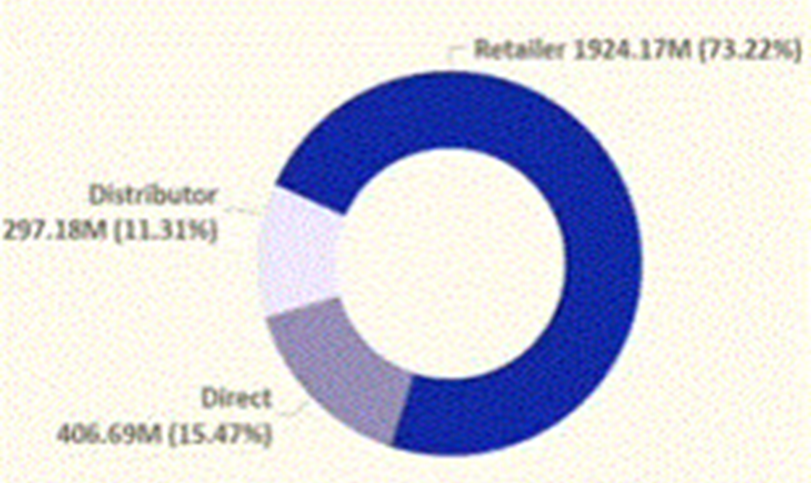
Result:
Request-09
Requirement:
Which channel helped to bring more gross sales in the fiscal year 2021 and the percentage of contribution?
Output:
Insights
Retailers drive most of Atliq sales,making up 73.22% of total gross sales.
Channel distributer makes the least contribution at a percentage of 11.31%

Slide 20
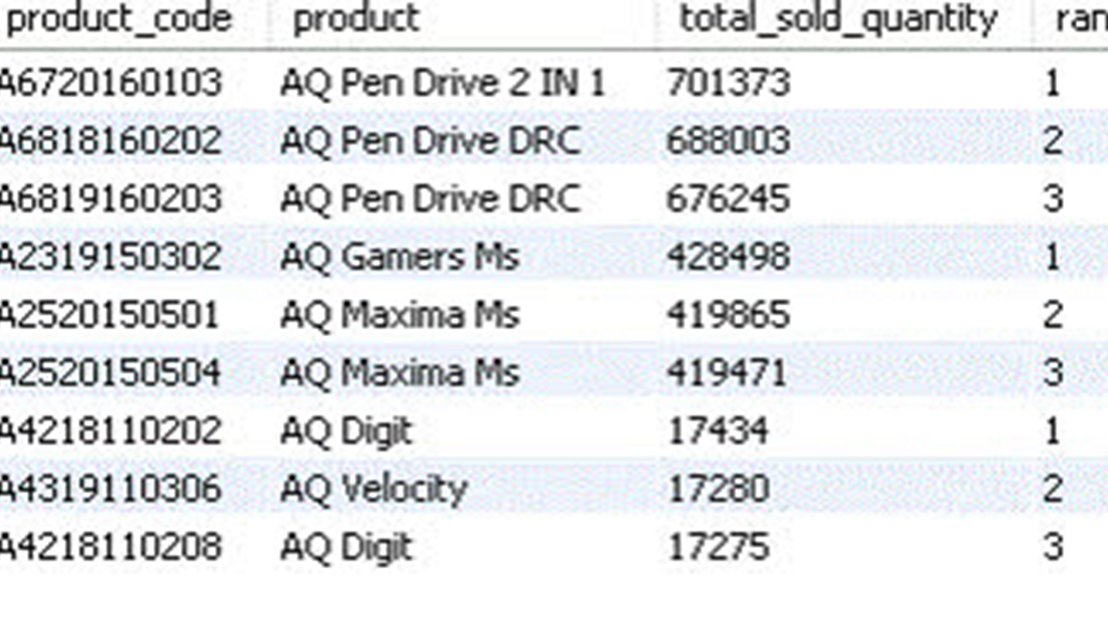
Request-10
Requirement:
I Get the Top 3 products in each division that have a high total_sold_quantity in the fiscal_year 2021?
Output:

Slide 21
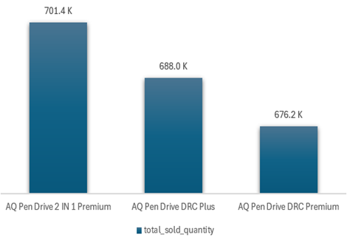
Insights
Every division has a product with different variants that appears twice in the top three products by division list.

Slide 22
Thank you

